Slide 1


Optimization of breeding schemes with GS in R
Friedrich Longin
State Plant Breeding Institute, University of Hohenheim, Stuttgart, Germany;
https://lsa-weizen.uni-hohenheim.de

Slide 2
Aims to learn
What are the key parameter to decide about breeding schemes?
Golden rules from selection theory
How is the R package selection gain constructed and how to use it for our questions
First steps into the R package
Source: pixabay.com
2

Slide 3
University of Hohenheim, Stuttgart
3 faculties
1 – life sciences (biology, physics, biotechnology, food production and ingredients); ~ 14 institutes
2 – agriculture (breeding, quantitative genetics, molecular genetics, agronomy, plant health, agroeconomics, animal sciences,…); ~ 15 institutes
3 – Economy (management, economics, law, social sciences…); ~ 8 institutes
~ 4000 students per year, all B.Sc. and M.Sc.
Master of crop science (english)
4 state institutes incorporated into the University
Experimental station for agriculture

Slide 4
Excellence Unit in Plant Breeding
Institute of Plant Breeding, Seed Science and Population Genetics
State Plant Breeding Institute
Subject Areas:
Applied Genetics and Plant Breeding Prof. Dr. Tobias Würschum
Crop Biodiversity and Breeding Informatics
Prof Dr. Karl Schmid
Seed Science and Technology Prof. Dr. Michael Kruse
Head: Dr. Patrick Thorwarth
Research groups:
Genomics & Biotechnology Dr. Kim Steige
Rye and Biotic Stress Resistance Prof. Dr. Thomas Miedaner
Triticale and Breeding Methodology Dr. Hans P. Maurer
Wheat Breeding and Selection Theory Prof. Dr. Friedrich Longin
Sunflower and Soybean Breeding Dr. Volker Hahn
Experimental Station

Slide 5
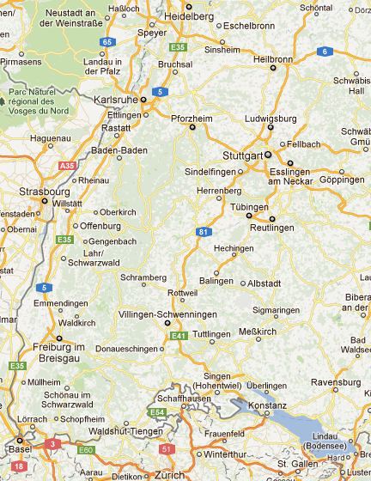
Experimental stations
Ihinger Hof
Heidfeldhof/Hohenheim
Kleinhohenheim/organic
Lindenhöfe
Eckartsweier
Five experimental stations ensure high-quality phenotyping which is the basis for breeding and science

Slide 6
State Plant Breeding Institute (LSA)
Six scientists with broad range of expertise,
PhD and PostDocs (from agronomy, bioinformatics, mathematics)
Experienced technical staff (>20) with phenotyping facilities, green houses, climate chambers, biotechlab,…
~ 20 peer-reviewed publications per year in leading international journals
~ 1.800.000€ extramural grants per year
Cooperations with leading international agricultural research centers (e.g. CAAS, CIMMYT, INRA, ACPFG, NIAB)
6

Slide 7
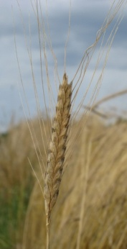
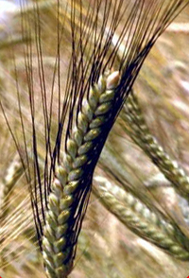
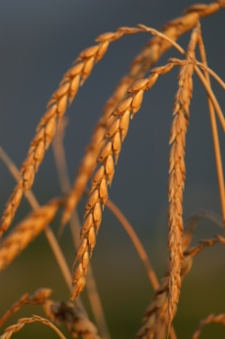
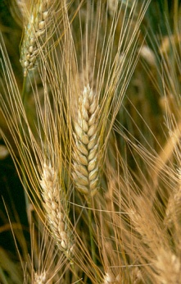
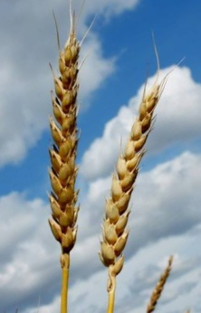
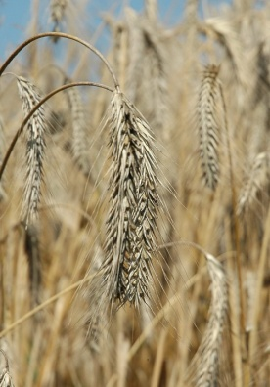
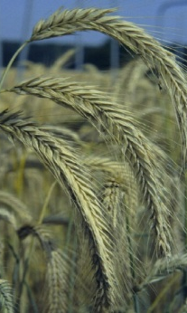
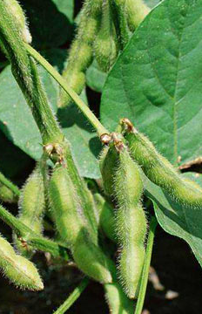

Breeding activities at the LSA
Einkorn
Emmer
Spelt
Durum
Wheat
Rye
Triticale
Soybean
Sunflower
LSA has competitive breeding programs
7

Slide 8
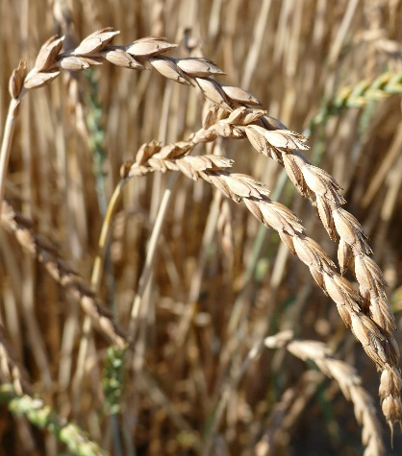
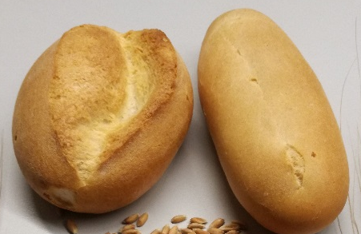
Wheat group - aims
Elite breeding in rare wheat species
Breeding programs in T. aestivum
Pre-Breeding for grain yield: aim to deliver material to community for elite breeding starts
Research accompanying these efforts
Genetic architecture of regarded traits
Special quality (wheat sensitivity, asparagine, aroma…)
Optimized breeding schemes
8

Slide 9
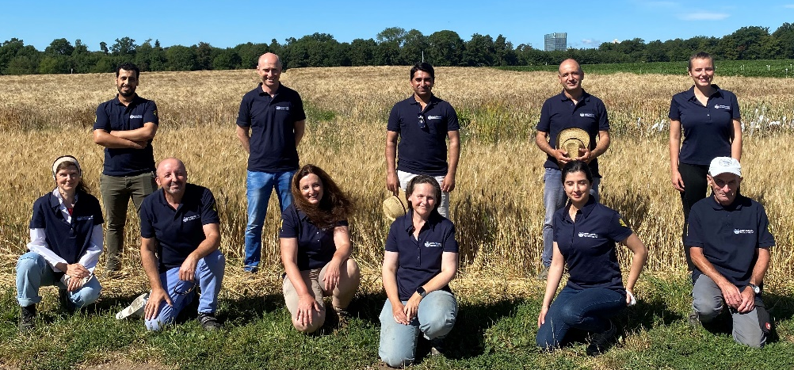
Wheat group
1 scientist – Dr. F. Longin
6 technicians
1 PostDoc, 2 PhD, students…
~ 8 ha of nurseries
> 30 different field locations
Special nurseries for stress - FHB, virus, frost
Quality lab for b- value, sds, falling, GI, protein content, vitreousness and dark points
Machinery for threshing and dehulling
https://weizen.uni-hohenheim.de/
9

Slide 10
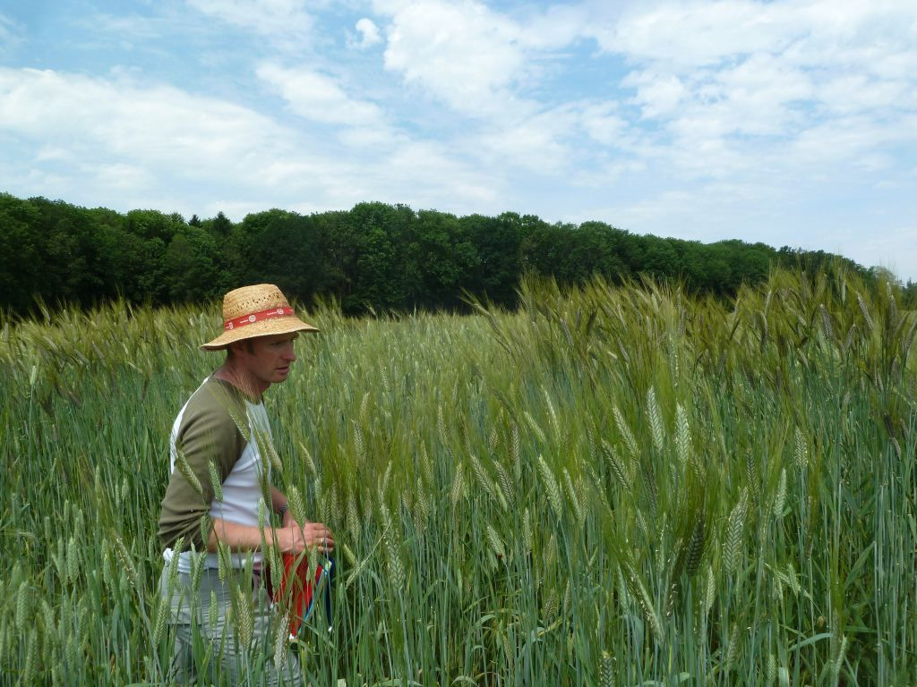

You are a breeder
Congratulations → fantastic job!
A breeder is the head of product development
You must be innovative
You must be able to rapidly take decisions
You must define the strategies
You must have success
You are responsible for whole product chain
10

Slide 11
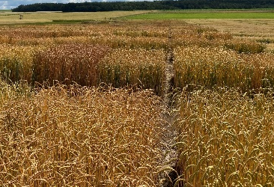
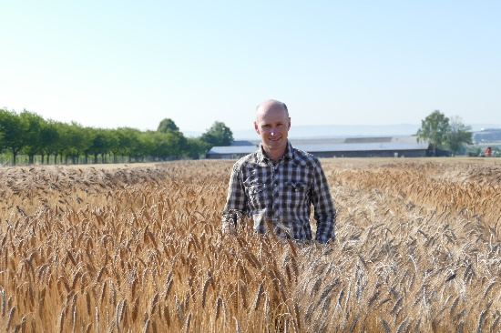
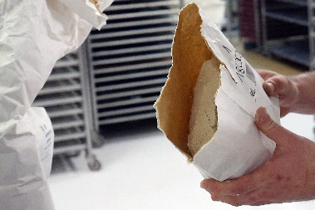
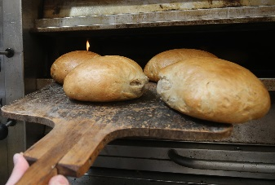
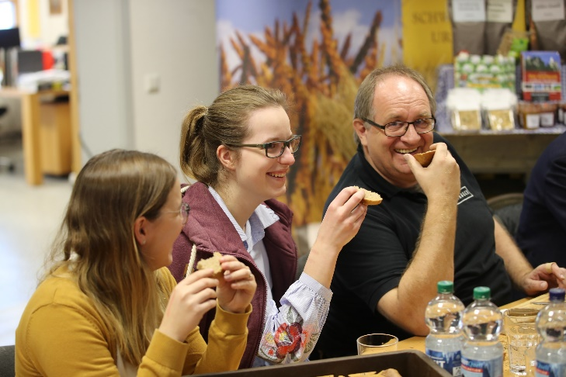
Wheat breeding – my framework
Breeder
Farmer
Miller
Baker
Consumer
€
Requests
Which of the supply chain requests have to be worked by me (the breeder)?
→ My market traits
Foto: BeckaBeck
11

Slide 12
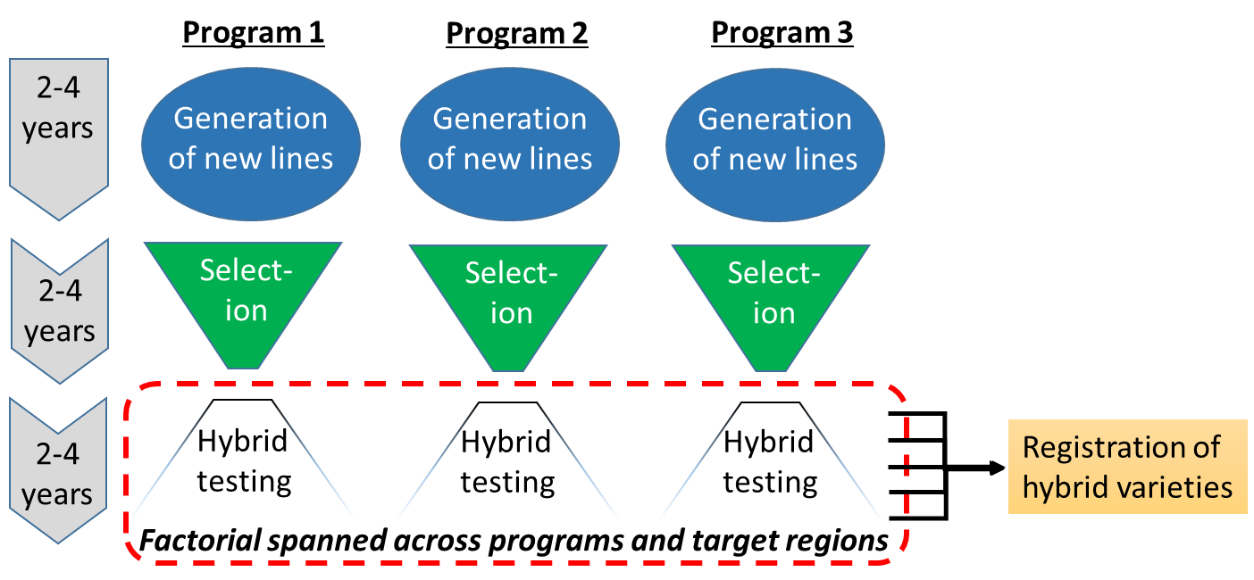
„Breeding get‘s a product chain“

Slide 13
„Breeding get‘s a product chain“
Breeder 1
Breeder 2
Breeder 3
Central market development team
Breeder delivers lines to market development team with high combining ability

Slide 14

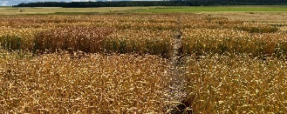
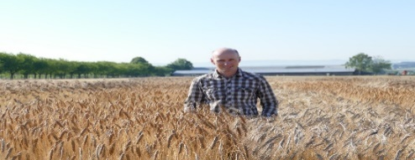



Breeding is teamwork
Phenomics
Quality lab
R & D Teams: Breeder is responsible for final outcome = decider
Genomics
Biostats
BREEDER
Breeder
Farmer
Miller
Baker
Consumer
14

Slide 15
You have to decide = you‘re responsible
Marketing tells you your specific framework
? Strategies ?
15

Slide 16
You have to decide = you‘re responsible
Marketing tells you your specific framework
? Strategies ?
Which breeding scheme ?
Which quality lab analyses ?
Molecular markers ?
Trial management ?
Priorisation of traits ?
Orga of phenotyping ?
Disease management ?
…
16

Slide 17
This lecture : decision support package
Marketing tells you your specific framework
? Strategies ?
Which breeding scheme ?
Which quality lab analyses ?
Molecular markers ?
Trial management ?
Priorisation of traits ?
Orga of phenotyping ?
Disease management ?
…
Other lectures
17

Slide 18
Let‘s start – what we will do
Introduction: Breeding categories → focus line breeding
Theorectical background of selection gain package: formula of selection gain
Variables influencing the selection gain
Important existing results
Realization in R package
GS breeding schemes
Important results
Realization in R package
Run your own first simulations
18

Slide 19

Beeing lost today
Second chance ☺
Search „Friedrich Longin“
https://www.youtube.com/channel/UCa5OSM9I-e2qBKBq7wQb4-w
19

Slide 20
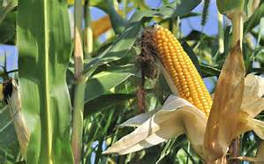
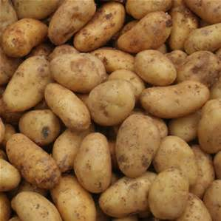
Breeding categories
Line breeding
Hybrid breeding
Clone breeding
Population breeding
Wheat
Maize
Potato
Rye
Source: Wikimedia
20

Slide 21
Line breeding based on per se performance
Line breeding
New breeding lines from DH, ssd,…
Field trials – per se performance
New line varieties
21

Slide 22
Hybrid breeding based on GCA
Line breeding
Hybrid breeding
New breeding lines from DH, ssd,…
New breeding lines in heterotic group 1
New breeding lines in heterotic group 2
GCA-Tester
GCA- Tester
Field trials – per se performance
Field trials – combining ability
New lines for hybrid production in heterotic group 1
New lines for hybrid production in heterotic group 2
New line varieties
22

Slide 23
3 Phases in a breeding scheme
Example: phenotypic selection in hybrid breeding
Year 1
P1 x P2, …
Year 2
DH-Production
Year 3
N₁ DH lines - multiplication
Hybrid seed prod.
N₂ * T₂
Year 4
Year 5
Field test
N₂ * T₂ * L₂
Year 6
Hybrid seed prod.
N₃ * T₃
Year 7
Field test
N₃ * T₃ * L₃
Source: Longin et al. 2015

Slide 24
3 Phases in a breeding scheme
PS_{standard}
Year 1
P1 x P2, …
Phase I: Producing new variation
Year 2
DH-Production
Phase II: Forming varietal parents
Year 3
N₁ DH lines - multiplication
Hybrid seed prod.
N₂ * T₂
Year 4
Year 5
Field test
N₂ * T₂ * L₂
Phase III: Testing experimental varieties
Year 6
Hybrid seed prod.
N₃ * T₃
Year 7
Field test
N₃ * T₃ * L₃
Source: Longin et al. 2015

Slide 25
Many questions…
PS_{standard}
Year 1
How many locations?
P1 x P2, …
Year 2
DH-Production
How many testers?
Year 3
N₁ DH lines - multiplication
Hybrid seed prod.
N₂ * T₂
How many lines?
Year 4
Year 5
Field test
N₂ * T₂ * L₂
How many years of field test?
Year 6
Hybrid seed prod.
N₃ * T₃
Use of markers? If yes which and when?
Year 7
Field test
N₃ * T₃ * L₃
Source: Longin et al. 2015

Slide 26
Option 1: Field trials
Year 1
P1 x P2, …
Year 2
DH-Production
Year 3
N₁ DH lines - multiplication
Hybrid seed prod.
N₂ * T₂
Year 4
Year 5
Field test
N₂ * T₂ * L₂
Year 6
Hybrid seed prod.
N₃ * T₃
Year 7
Field test
N₃ * T₃ * L₃
e.g. 1: maximum N → minimum L
Source: Longin et al. 2015

Slide 27
Option 1: Field trials
Year 1
P1 x P2, …
P1 x P2, …
Year 2
DH-Production
DH-Production
Year 3
N₁ DH lines - multiplication
N₁ DH lines - multiplication
Hybrid seed prod.
N₂ * T₂
Hybrid seed prod.
N₂ * T₂
Year 4
Year 5
Field test
N₂ * T₂ * L₂
Field test
N₂ * T₂ * L₂
Year 6
Hybrid seed prod.
N₃ * T₃
Hybrid seed prod.
N₃ * T₃
Year 7
Field test
N₃ * T₃ * L₃
Field test
N₃ * T₃ * L₃
e.g. 1: maximum N → minimum L
e.g. 2: minimum N → maximum L
Source: Longin et al. 2015

Slide 28
Option 1: Field trials
Year 1
P1 x P2, …
P1 x P2, …
P1 x P2, …
Year 2
DH-Production
DH-Production
DH-Production
Year 3
N₁ DH lines - multiplication
N₁ DH lines - multiplication
N₁ DH lines - multiplication
Hybrid seed prod.
N₂ * T₂
Hybrid seed prod.
N₂ * T₂
Hybrid seed prod.
N₂ * T₂
Year 4
Year 5
Field test
N₂ * T₂ * L₂
Field test
N₂ * T₂ * L₂
Field test
N₂ * T₂ * L₂
Year 6
Hybrid seed prod.
N₃ * T₃
Hybrid seed prod.
N₃ * T₃
Year 7
Field test
N₃ * T₃ * L₃
Field test
N₃ * T₃ * L₃
e.g. 1: maximum N → minimum L
e.g. 2: minimum N → maximum L
e.g. 3: 1 year less field trials
Source: Longin et al. 2015

Slide 29
Option 1: Field trials
Year 1
P1 x P2, …
P1 x P2, …
P1 x P2, …
Year 2
DH-Production
DH-Production
DH-Production
Ceteris paribus
1 test requires 7 years!
Confirmation in different years
→ Option 1 is not feasible
Year 3
N₁ DH lines - multiplication
N₁ DH lines - multiplication
N₁ DH lines - multiplication
Hybrid seed prod.
N₂ * T₂
Hybrid seed prod.
N₂ * T₂
Hybrid seed prod.
N₂ * T₂
Year 4
Year 5
Field test
N₂ * T₂ * L₂
Field test
N₂ * T₂ * L₂
Field test
N₂ * T₂ * L₂
Year 6
Hybrid seed prod.
N₃ * T₃
Hybrid seed prod.
N₃ * T₃
Year 7
Field test
N₃ * T₃ * L₃
Field test
N₃ * T₃ * L₃
e.g. 1: maximum N → minimum L
e.g. 2: minimum N → maximum L
e.g. 3: 1 year less field trials
Source: Longin et al. 2015

Slide 30
Option 2: Simulation of breeding methods
Year 1
P1 x P2, …
Prediction the gain from selection in breeding schemes → Breeder‘s equation
Simulation of different breeding schemes
R Package „selection gain“
Year 2
DH-Production
Year 3
N₁ DH lines - multiplication
Hybrid seed prod.
N₂ * T₂
Year 4
Year 5
Field test
N₂ * T₂ * L₂
Year 6
Hybrid seed prod.
N₃ * T₃
Year 7
Field test
N₃ * T₃ * L₃
e.g. 1: maximum N → minimum L
Source: Longin et al. 2015

Slide 31
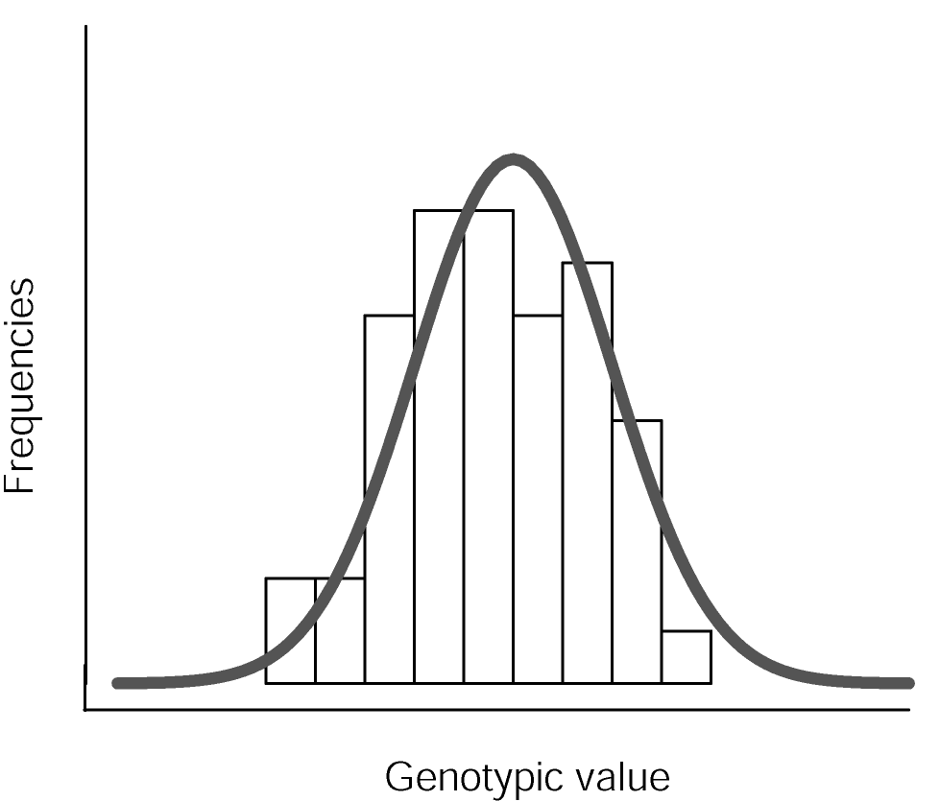
Choice of breeding method
Concept of selection gain
Distribution of phenotypes in the field for quantitative traits:
P = G + E;
In R:
rnorm (N, 0, σ²_{G} + σ²_{E})
Phenotypic value
31

Slide 32
Selection gain
Post-test = realized:
Prae-test = predicted:
α
μ
μ'
Phenotypic value
32

Slide 33
Prediction of selection gain
Selection gain
i = selection intensity,
h = square root of the heritability,
σ_{y} = square root of the genetic variance of the target variable
Annual selection gain
Y = no. of years required to finish one breeding cycle
33

Slide 34
Variables influencing selection gain
Annual selection gain
i = selection intensity,
h = square root of the heritability,
σ_{y} = square root of the genetic variance of the target variable
Y = no. of years required to finish one breeding cycle
Selection gain is maximized by an
Increase of i → reduction of Y
Increase of h
Increase of σ_{y}
34

Slide 35
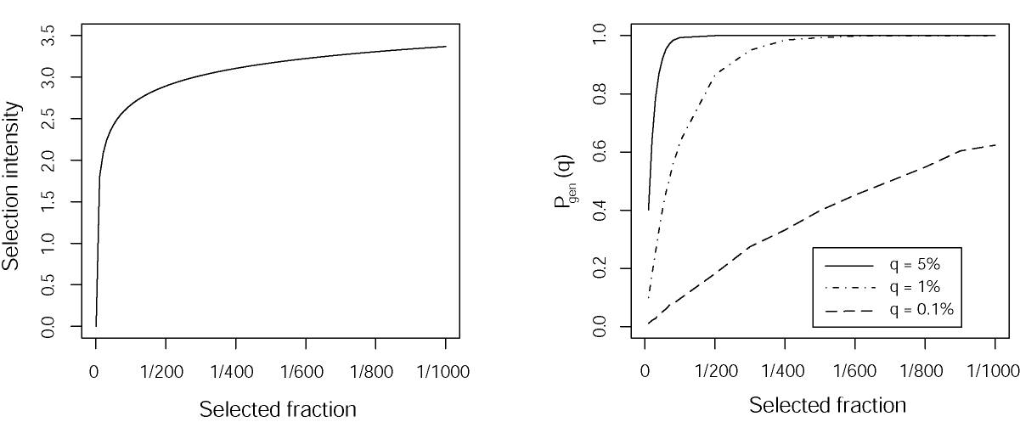
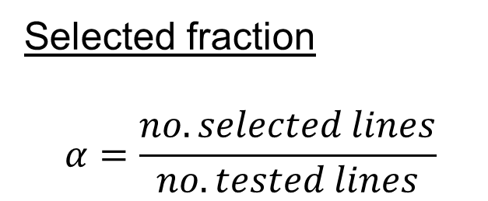
Increasing selection intensity
Selected fraction
$$α=\frac{no. selected lines}{no. tested lines}$$
Selection intensity is increased by
Increasing the number of tested lines
Decreasing the number of selected lines
BUT: Increase is not linear
Source: Becker 1993
35

Slide 36
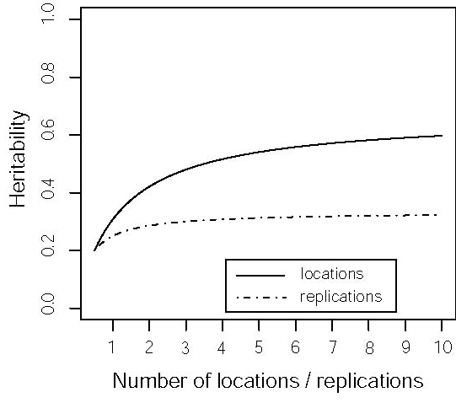
Increasing heritability
L = Locs, R = Reps, σ²_{G} = genet. variance; σ²_{P} = phenotyp. variance, σ²_{GxE} = variance due to Genotyp-environment - interaction; σ²_{e} = error variance
→ estimated via ANOVA
Heritability is increased by
Increasing the number of locations
Increasing the number of replications, but less than for locations!
BUT: Increase is not linear
Source: Becker 1993
36

Slide 37
Allocation of resources
Allocation of resources
i: function of α = N_{sel}/N₁
→
L = Locs, R = Reps, σ²_{G} = genet. variance; σ²_{P} = phenotyp. variance, σ²_{GxE} = variance due to Genotyp-environment - interaction; σ²_{e} = error variance
→ estimated via ANOVA
37

Slide 38
Optimize allocation of resources
Framework
Target criteria: maximize selection gain
Variables to optimze:
No. of locations
No. of replications
No. of lines
No. of testers, type of tester
Splitting of lines on crosses and lines within crosses
→ Fixed annual budget
38

Slide 39
Budget of a breeding program = annual budget
Budget: horizontal and vertical!
39

Slide 40

Examples for budgets per program
Maize
Large: >1.000.000€
Small: ~ 500.000€
Wheat
Large: 1.000.000€
Small: 200.000€
Barley
Large: 400.000€
Small: 100.000€
40

Slide 41
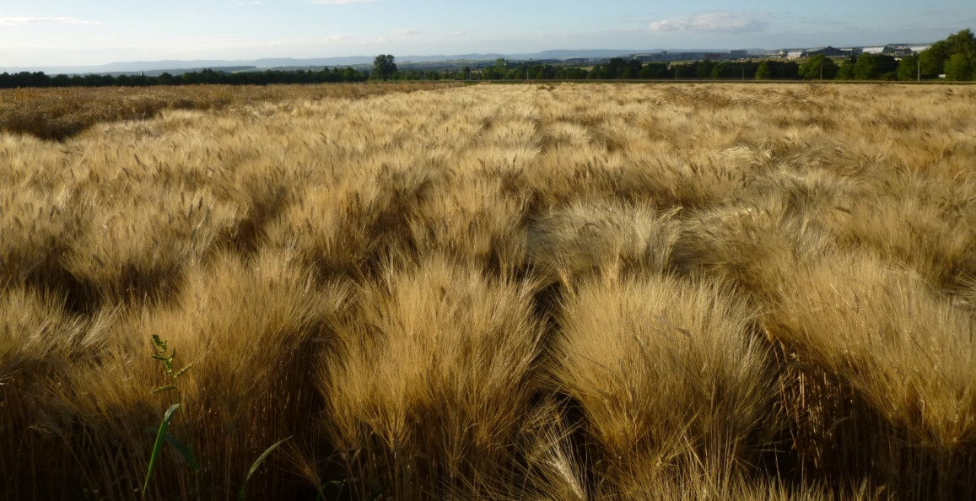
Budget of a breeding program
Staff: 125.000€
Breeder = 75.000 €
1 Technician = 40.000€
Seasonal workers = 5.000€
Travelling, car, mobile, computer,… = 5.000€
DH Lab: 150.000€
Marker Lab: 40.000€
Quality Lab: 20.000€
Field: 250.000€
Rows: 50.000 €
Yield plots: 200.000€
Further costs: ??
Machinery
Seed maintenance
Consumables: 10.000€
Annual budget: 600.000€
Source: Sieber
41

Slide 42
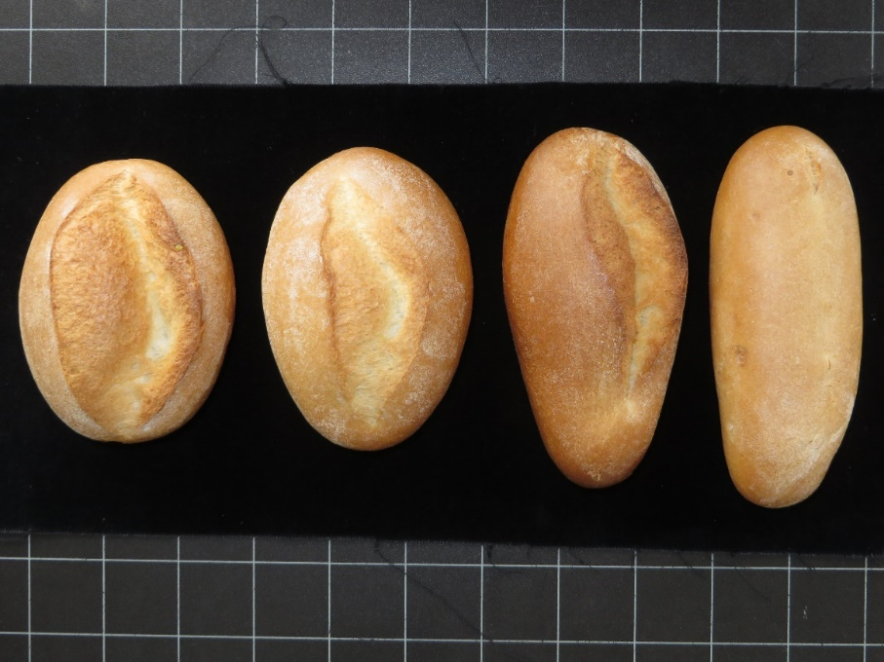
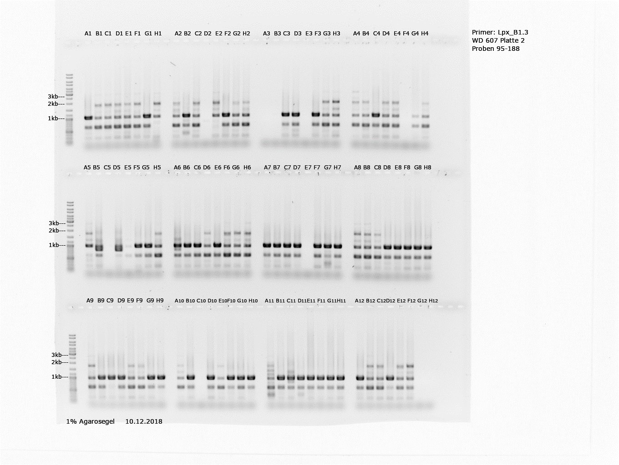
Costs – wheat
Molecular markers
For major QTL: 0.5€ per data point
Genome wide: 40€ per line
Quality
Protein: NIRS: 2€ / sample
SDS : 15€ / sample
Dough tests: 100€/sample
Baking test: 100€/sample
Field costs
DH line: 20 €
F3 – row: 2€
Special nursery: row: 5€
Yield plot: 25 €; 35 € (external)
Just an example
Source: Leiser, Würschum
42

Slide 43
Dimension of a wheat program
Just an example
Lines
200 crosses/year
50 crosses * 150 lines → DH = 7500 lines
150 crosses * 1000 F2 plants → 20.000 F3 rows
Yield test 1: 2000 lines at 4 Locs
Yield test 2: 250 lines at 8 Locs
Marker Lab
10.000 F2 plants on 5 major QTL = 25.000€
250 lines genome wide * 40 = 10.000€
Quality Lab
Best 30 lines from yield test 2 from 8 locs = 240 samples
Baking + dough = 240 * 80 = 19.200€
43

Slide 44
Simple budget formula
Budget = N*L*R (*T) + Production of N
N = no. of test candidates
L = no. of test locations
R = no. of replications
T = no. of testers
44

Slide 45
Selection intensity vs. heritability
For a fixed budget, maximization of ∆G represents a compromise between a high number of test candidates and a high intensity of testing.
Quelle: Becker 1993
45

Slide 46
Golden rule
For a fixed budget, maximization of ∆G represents a compromise between a high number of test candidates and a high intensity of testing.
Golden rule: Curves of i and h² level off and increase by L > than in R
Quelle: Becker 1993
46

Slide 47
Variables influencing selection gain
Annual selection gain
i = selection intensity,
h = square root of the heritability,
σ_{y} = square root of the genetic variance of the target variable
Y = no. of years required to finish one breeding cycle
Selection gain is maximized by an
Increase of i → reduction of Y
Increase of h
Increase of σ_{y}
47

Slide 48
Reduce cycle length
PS_{standard}
GS_{rapid}
Year 1
P1 x P2, …
P1 x P2, …
Year 2
DH-Production
DH-Production
Year 3
N₁ DH lines - multiplication
N₁ DH lines - multiplication
Genomic selection N₁
Hybrid seed prod.
N₂ * T₂
Hybrid seed prod.
N₂ * T₂
Year 4
Year 5
Field test
N₂ * T₂ * L₂
Field test
N₂ * T₂ * L₂
Year 6
Hybrid seed prod.
N₃ * T₃
2 years faster breeding scheme
Year 7
Field test
N₃ * T₃ * L₃
Source: Longin et al. 2016

Slide 49
Annual selection gain
Assumptions:
i = 2
h = 0.7
σ_{y} = 5 dt/ha
Example:
> 40 % higher annual selection gain
Cycle length has very strong effect on annual selection gain
→You must be faster than your competitor
49

Slide 50
Variance components
Source: Laidig et al. 2008
50

Slide 51
Variance components
High variance due to
genotype x year and
genotype x year x location interaction
Source: Laidig et al. 2008
51

Slide 52
Year → large effect on genotype ranking
Further advantages of multiple year testing
Disease resistance (natural occurring)
Frost
Drought, heat
Speed of the program is also a compromise between a maximum annual selection gain and a security of the results
52

Slide 53
Compromise necessary
Annual selection gain
Annual selection gain is maximized by an
increase of i → reduction of Y
increase of h
increase of σ_{y}
Compromise necessary between theory and practice!
53

Slide 54
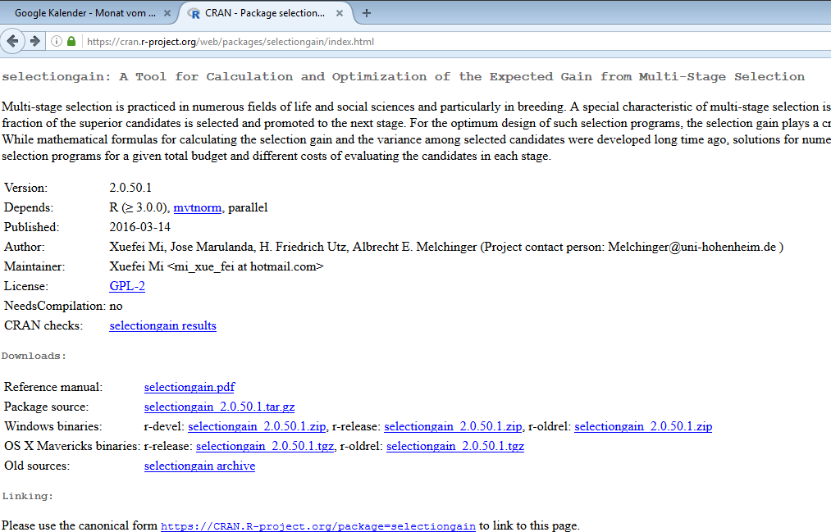
R package „selection gain“
Open source software package R (www.r-project.org)
Package selectiongain
https://cran.r-project.org/web/packages/selectiongain/index.html
54

Slide 55

Selectiongain - Manual
55

Slide 56
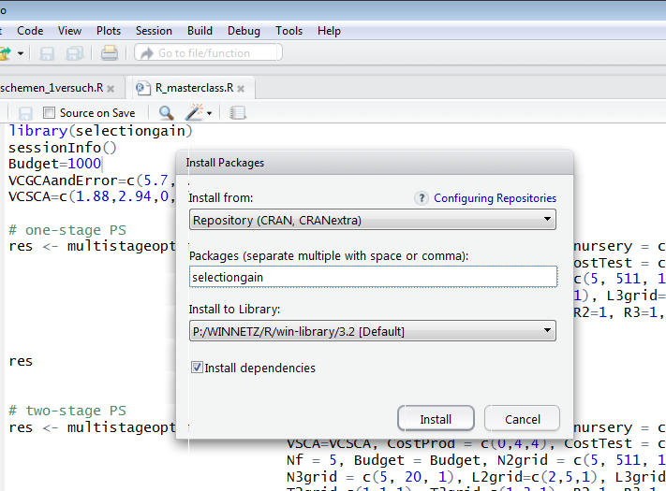
Selectiongain - download
56

Slide 57
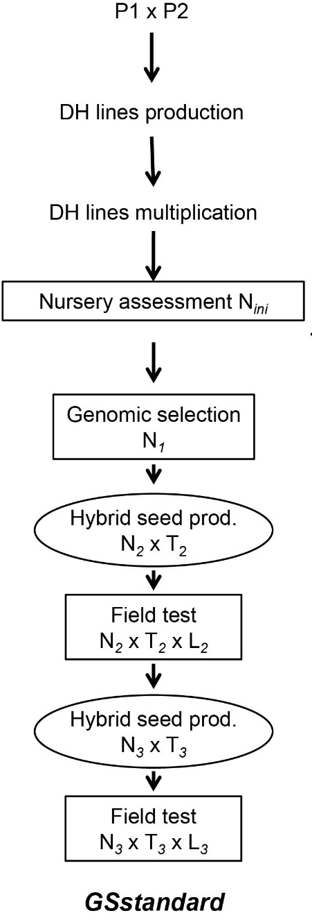
What is possible? – Breeding scheme
Breeding scheme:
DH production
Nursery selection on traits not correlated to yield
GS on yield
2 stage phenotypic selection on yield
N_{i} , L_{i} , R_{i} , T_{i} = number of lines, locations, replications and testers used in stage i → optimized
57

Slide 58
What is possible? – Breeding scheme
Breeding scheme:
DH production
Nursery selection on traits not correlated to yield
GS on yield
2 stage phenotypic selection on yield
Breeding scheme - modifications
Each test stage can be switched off
You can enter minimum/maximum numbers in each test stages of N, L, R, T
GS → yes/no
58

Slide 59
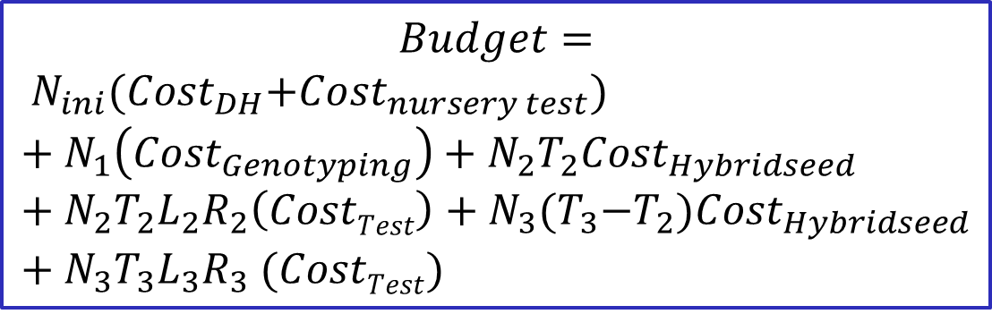
Budget & Costs
$$Budget=$$
$$N_{ini}{(Cost}_{DH}+{Cost}_{nursery test})+N_{1}\left({Cost}_{Genotyping}\right)+N_{2}T_{2}{Cost}_{Hybridseed}+N_{2}T_{2}L_{2}R_{2}\left(CostTest\right)+N_{3}{(T}_{3}−T_{2}){Cost}_{Hybridseed}+N_{3}T_{3}L_{3}R_{3} (CostTest)$$
Costs for:
DH production
Nursery selection
GS
Hybrid seed production
Field plot,….
→ All „redefined“ in field plot equivalents
59

Slide 60
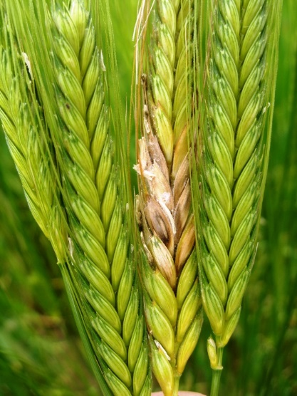
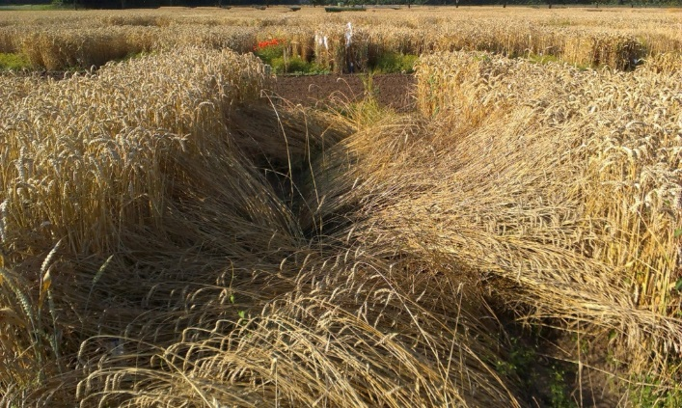
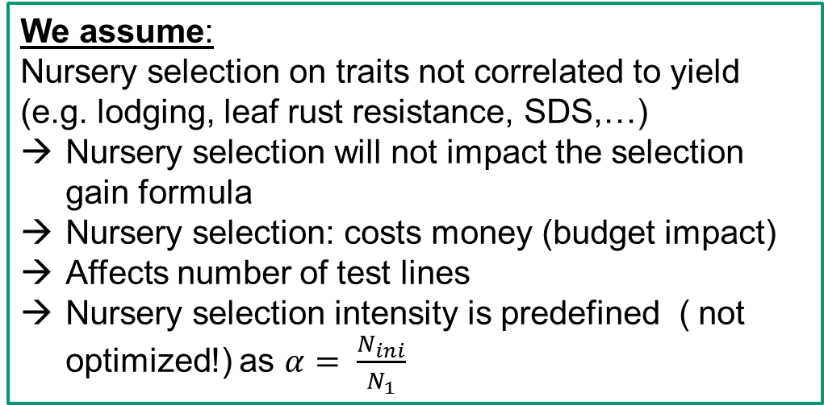
Nursery selection
We assume:
Nursery selection on traits not correlated to yield (e.g. lodging, leaf rust resistance, SDS,…)
Nursery selection will not impact the selection gain formula
Nursery selection: costs money (budget impact)
Affects number of test lines
Nursery selection intensity is predefined ( not optimized!) as $α= \frac{N_{ini}}{N_{1}}$
60

Slide 61
First step of simulations
We define basics:
Budget (for crossing, line development, GS, field tests) in field plot equivalents
Crop & Trait to select for → variance components
σ²_{GCA} = GCA variance; σ²_{SCA} = SCA variance ; σ²_{P} = phenotyp. variance, σ²_{GCAx…} = variance due to Genotyp-environment - interaction; σ²_{e} = error variance
→ estimated via ANOVA
61

Slide 62
Getting started with the code
library(selectiongain) → load the package
sessionInfo() → Info on the version you use
Important input parameters
Budget = in field plot eqivalents
VCGCAandError =
c(GCA,GCA*loc, GCA*year, GCA*loc*year, error)
VCSCA = c(SCA, SCA*loc, SCA*year, SCA*loc*year)
Example for hybrid wheat:
Budget =10 000
VCGCAandError=c(5.7, 5.19, 0, 0, 24.37)
VCSCA=c(1.88, 2.94, 0,0)
62

Slide 63
Second step of simulations
We define breeding operations:
Intensity of nursery selection
GS: yes/no; predictive ability
Number of test stages in field
Maximum numbers of testers, locations,…
Costs for each operation
63

Slide 64
Most important code
Budget = 10000
VCGCAandError = c(5.7,5.19,0,0,24.37)
VCSCA = c(1.88,2.94,0,0)
multistageoptimum.search (
maseff=NA, alpha.nursery = 1,
VGCAandE=VCGCAandError, VSCA=VCSCA, cost.nursery = c(1,0.3), CostProd = c(0,4,4),
CostTest = c(2,1,1), t2free = T,
Nf = 5, Budget = Budget,
N2grid = c(Nf, 511, 10), N3grid = c(Nf, 20, 1),
L2grid=c(2,5,1), L3grid=c(1,5,1),
T2grid=c(1,1,1), T3grid=c(1,5,1),
R2=1, R3=1, alg = Miwa(),
detail=FALSE, fig=FALSE)
Nf Nini N1 N2 N3 L2 L3 T2 T3 R2
5.000 204.000 0.000 51.000 9.800 5.000 10.000 1.000 2.000 1.000
R3 Bini B1 B2 B3 Budget Gain
1.000 265.200 0.000 459.000 274.900 1000.000 3.278
ΔG
64

Slide 65
Most important code - explained
multistageoptimum.search (
maseff = GS pred. abbility,
alpha.nursery = selected fraction in disease nursery,
VGCAandE=VCGCAandError, VSCA=VCSCA, cost.nursery = c(line prod., test in nursery),
CostProd = c(0, hybrid seed prod., hybrid seed prod.),
CostTest = c(GS, yield plot, yield plot), t2free = T,
Nf = no. finally selected lines, Budget = Budget,
N2grid = c(startpoint, endpoint, gridsteps), N3grid = c(startpoint, endpoint, gridsteps),
L2grid=c(startpoint, endpoint, gridsteps), L3grid=c(startpoint, endpoint, gridsteps),
T2grid=c(startpoint, endpoint, gridsteps), T3grid=c(startpoint, endpoint, gridsteps),
R2=1, R3=1, alg = Miwa(),
detail=FALSE, fig=FALSE)
65

Slide 66
Step by step: nursery
multistageoptimum.search (
maseff=0.2, alpha.nursery = 0.3,
VGCAandE=VCGCAandError, VSCA=VCSCA,
cost.nursery = c(1, 0.3),
CostProd = c(0,4,4),
CostTest = c(2,1,1),
Nf = 5, Budget = Budget,
N2grid = c(Nf, 511, 10), N3grid = c(Nf, 20, 1),
L2grid=c(2,5,1), L3grid=c(1,5,1),
T2grid=c(1,1,1), T3grid=c(1,5,1),
R2=1, R3=1,
alg = Miwa(), detail=FALSE, fig=FALSE)
66

Slide 67
Step by step: Genomic selection
multistageoptimum.search (
maseff=0.2, alpha.nursery = 0.3,
VGCAandE=VCGCAandError, VSCA=VCSCA,
cost.nursery = c(1, 0.3),
CostProd = c(0,4,4),
CostTest = c(2,1,1),
Nf = 5, Budget = Budget,
N2grid = c(Nf, 511, 10), N3grid = c(Nf, 20, 1),
L2grid=c(2,5,1), L3grid=c(1,5,1),
T2grid=c(1,1,1), T3grid=c(1,5,1),
R2=1, R3=1,
alg = Miwa(), detail=FALSE, fig=FALSE)
67

Slide 68
Step by step: Hybrid seed production
multistageoptimum.search (
maseff=0.2, alpha.nursery = 0.3,
VGCAandE=VCGCAandError, VSCA=VCSCA,
cost.nursery = c(1, 0.3),
CostProd = c(0,4,4),
CostTest = c(2,1,1),
Nf = 5, Budget = Budget,
N2grid = c(Nf, 511, 10), N3grid = c(Nf, 20, 1),
L2grid=c(2,5,1), L3grid=c(1,5,1),
T2grid=c(1,1,1), T3grid=c(1,5,1),
R2=1, R3=1,
alg = Miwa(), detail=FALSE, fig=FALSE)
68

Slide 69
Step by step: Field test 1
multistageoptimum.search (
maseff=0.2, alpha.nursery = 0.3,
VGCAandE=VCGCAandError, VSCA=VCSCA,
cost.nursery = c(1, 0.3),
CostProd = c(0,4,4),
CostTest = c(2,1,1),
Nf = 5, Budget = Budget,
N2grid = c(Nf, 511, 10), N3grid = c(Nf, 20, 1),
L2grid=c(2,5,1), L3grid=c(1,5,1),
T2grid=c(1,1,1), T3grid=c(1,5,1),
R2=1, R3=1,
alg = Miwa(), detail=FALSE, fig=FALSE)
69

Slide 70
Step by step: Field test 2
multistageoptimum.search (
maseff=0.2, alpha.nursery = 0.3,
VGCAandE=VCGCAandError, VSCA=VCSCA,
cost.nursery = c(1, 0.3),
CostProd = c(0,4,4),
CostTest = c(2,1,1),
Nf = 5, Budget = Budget,
N2grid = c(Nf, 511, 10), N3grid = c(Nf, 20, 1),
L2grid=c(2,5,1), L3grid=c(1,5,1),
T2grid=c(1,1,1), T3grid=c(1,5,1),
R2=1, R3=1,
alg = Miwa(), detail=FALSE, fig=FALSE)
70

Slide 71
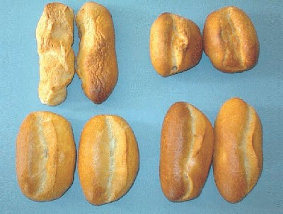
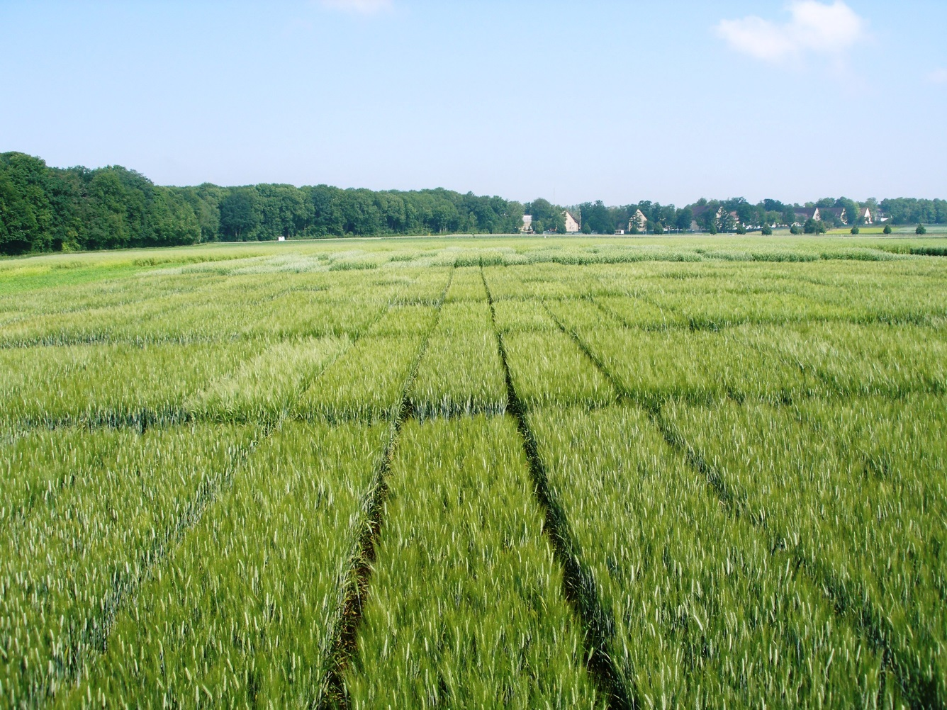
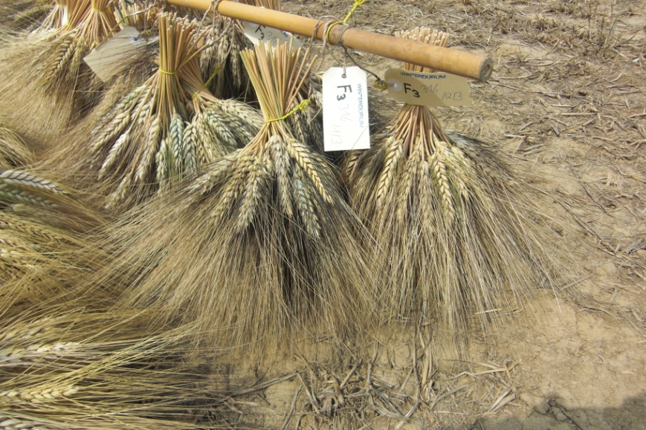
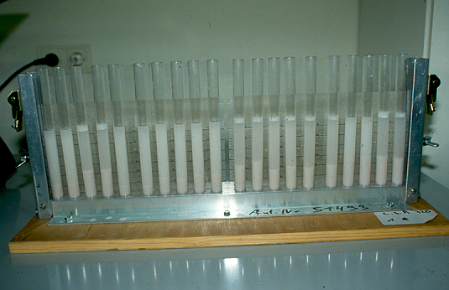
Let‘s go into breeding world
71

Slide 72
Modeling the optimum allocation
1. Basic level
Target criterion
Trait
2. Breeding level
Scheme
Scenario
3. Optimization level
Test resources
72

Slide 73
Modeling the optimum allocation
1. Basic level
Target criterion = selection gain
Trait = grain yield in wheat
2. Breeding level
Scheme = PS standard
Scenario = variance components, budget, selected
fraction, technical requirements,...
3. Optimization level
Test resources = number of test locations, testers,
replications, DH lines
73

Slide 74
Determining the opt. allocation within a given model framework
1. Basic level
Selection gain
Wheat grain yield
2. Breeding level
PSstandard
Given scenario
3. Optimization level
specific allocation of the number
of testers, test locations,
DH lines, replications
Computation of
target criterion
Computation of
target criterion
Computation of
target criterion
AIM: Find the allocation maximizing selection gain for that specific def. of level 1 and 2
= optimum allocation
Computation of
target criterion
Computation of
target criterion
Computation of
target criterion
Computation of
target criterion
74

Slide 75
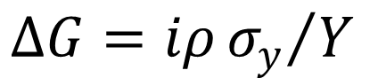
Use of molecular markers
Nothing else than indirect selection
$$∆G=iρ{σ_{y}}/Y$$
0 < ρ < 1: selection gain is only increased if the use of the test criteria enables
Increase of i → high throughput: N₁
Increase of h
Increase of σ_{y}
Decrease of Y → fast recycling
75

Slide 76
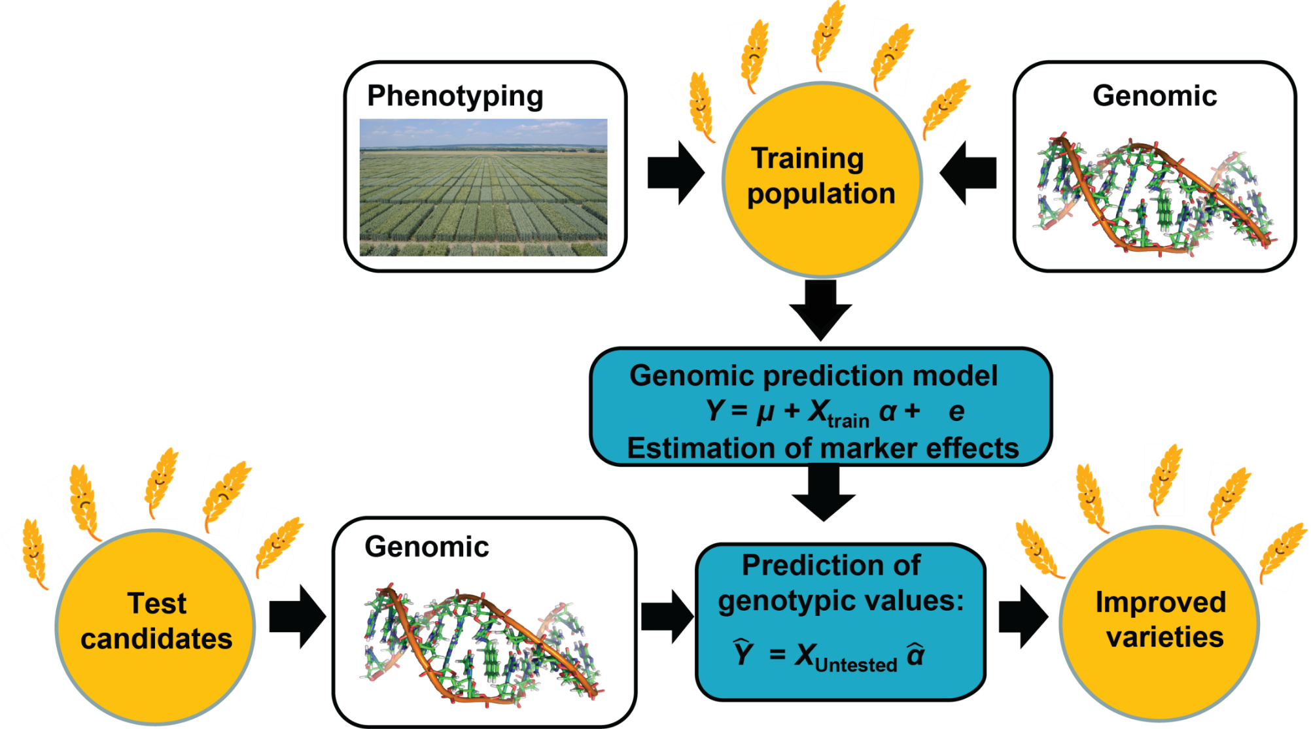
Genomic selection
We assume, that
prediction models have been developed in previous projects → no budget required for it now!
Retraining of the model is done with routine field trials → no additional budget required for it!
Source: Zhao et al. 2015
76

Slide 77
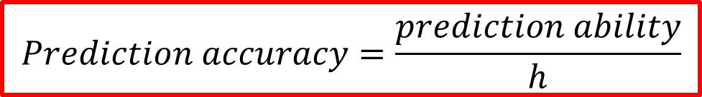
We need prediction ability
Correlation between observed and predicted breeding value = prediction ability
→ that‘s what we need for our simulations
$$Prediction accuracy=\frac{prediction ability}{h}$$
77

Slide 78
Modifications of the framework
Besides budget, variance components, costs for line production and phenotyping we need further data:
Correlation GS with GCA: ρ(GS, GCA)= 0.3 (for T0 scenario; Zhao et al. 2014)
Costs GS = high density genotyping of 1 line costs as much as 2 field plots
(data is shown for wheat with framwork based on papers below)
Source: Longin et al. 2016, Marulanda et al. 2016
78

Slide 79
Breeding schemes
PS_{standard}
Year 1
P1 x P2, …
Year 2
DH-Production
Year 3
N₁ DH lines - multiplication
Hybrid seed prod.
N₂ * T₂
Year 4
Year 5
Field test
N₂ * T₂ * L₂
Year 6
Hybrid seed prod.
N₃ * T₃
Year 7
Field test
N₃ * T₃ * L₃
Year 8, 9,…
Pre-registration trials
Source: Longin et al. 2015

Slide 80
Breeding schemes
PS_{standard}
GS_{standard}
Year 1
P1 x P2, …
P1 x P2, …
Year 2
DH-Production
DH-Production
Year 3
N₁ DH lines - multiplication
N₁ DH lines - multiplication
Genomic selection N₁
Hybrid seed prod.
N₂ * T₂
Hybrid seed prod.
N₂ * T₂
Year 4
Year 5
Field test
N₂ * T₂ * L₂
Field test
N₂ * T₂ * L₂
Year 6
Hybrid seed prod.
N₃ * T₃
Hybrid seed prod.
N₃ * T₃
Year 7
Field test
N₃ * T₃ * L₃
Field test
N₃ * T₃ * L₃
Source: Longin et al. 2015

Slide 81
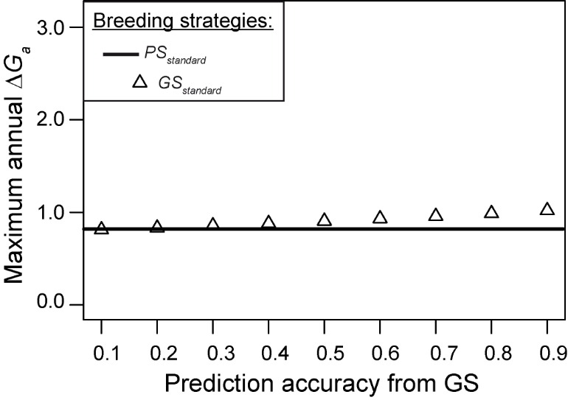
Increase in selection gain with GS
?
The higher the prediction accuracy the larger is the advantage of GS schemes
Source: Longin et al. 2015

Slide 82
Reduce cycle length with GS
PS_{standard}
GS_{standard}
GS_{rapid}
GS_{only}
Year 1
P1 x P2, …
P1 x P2, …
P1 x P2, …
P1 x P2, …
Year 2
DH-Production
DH-Production
DH-Production
DH-Production
Year 3
N₁ DH lines - multiplication
N₁ DH lines - multiplication
N₁ DH lines - multiplication
N₁ DH lines - multiplication
Genomic selection N₁
Genomic selection N₁
Genomic selection N₁
Hybrid seed prod.
N₂ * T₂
Hybrid seed prod.
N₂ * T₂
Hybrid seed prod.
N₂ * T₂
Year 4
Year 5
Field test
N₂ * T₂ * L₂
Field test
N₂ * T₂ * L₂
Field test
N₂ * T₂ * L₂
Year 6
Hybrid seed prod.
N₃ * T₃
Hybrid seed prod.
N₃ * T₃
Year 7
Field test
N₃ * T₃ * L₃
Field test
N₃ * T₃ * L₃
Source: Longin et al. 2015

Slide 83
Reduce cycle length with GS
PS_{standard}
GS_{standard}
GS_{rapid}
GS_{only}
Year 1
P1 x P2, …
P1 x P2, …
P1 x P2, …
P1 x P2, …
Year 2
DH-Production
DH-Production
DH-Production
DH-Production
Year 3
N₁ DH lines - multiplication
N₁ DH lines - multiplication
N₁ DH lines - multiplication
N₁ DH lines - multiplication
Genomic selection N₁
Genomic selection N₁
Genomic selection N₁
Hybrid seed prod.
N₂ * T₂
Hybrid seed prod.
N₂ * T₂
Hybrid seed prod.
N₂ * T₂
Year 4
Year 5
Field test
N₂ * T₂ * L₂
Field test
N₂ * T₂ * L₂
Field test
N₂ * T₂ * L₂
Up to 4 years faster breeding schemes feasible with GS
Year 6
Hybrid seed prod.
N₃ * T₃
Hybrid seed prod.
N₃ * T₃
Year 7
Field test
N₃ * T₃ * L₃
Field test
N₃ * T₃ * L₃
Source: Longin et al. 2015

Slide 84
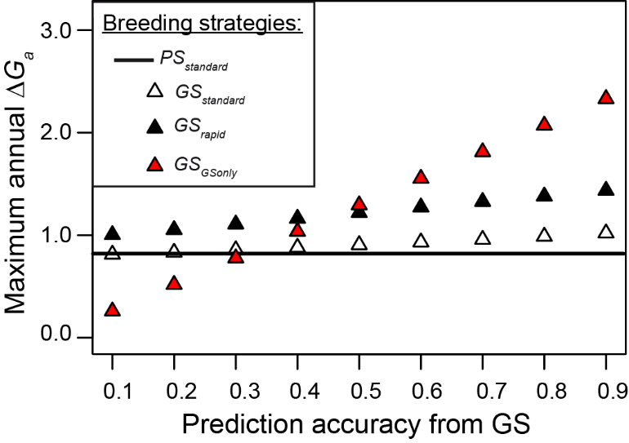
GS for yield is interesting
Genomic selection is promising for grain yield especially when used to shorten breeding cycle length
Source: Longin et al. 2015

Slide 85
GS for yield is interesting
With recent GS accuracy breeding scheme GS_{rapid} seems most promising: + 35% in annual selection gain
Source: Longin et al. 2015

Slide 86
Generalisation of results
We state that a breeding scheme using GS, namely GSrapid, is top and should be used; but is it also the truth for
small budgets ?
different variance components ?
reduced hybrid seed production costs ?

Slide 87
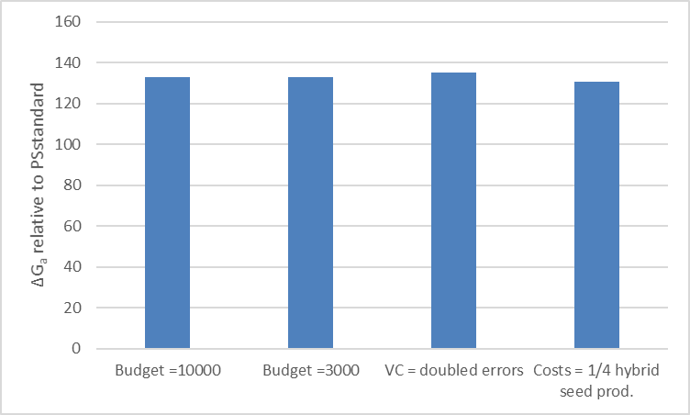
Broad advantage of GSrapid
The use of GS in elite breeding is recommended for a broad range of scenarios; also for small breeding programs!
Source: Marulanda et al. 2016

Slide 88
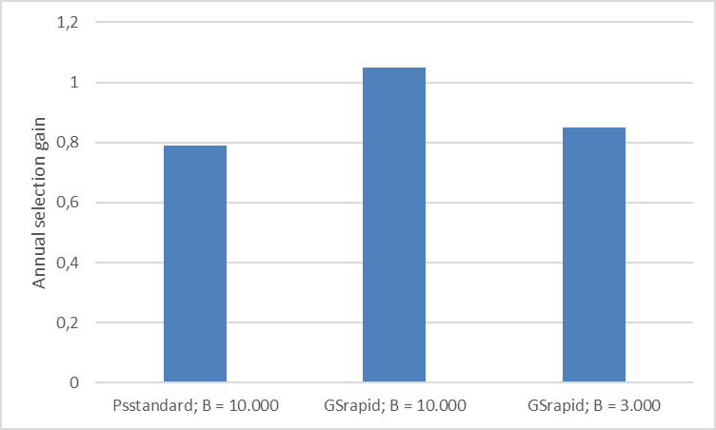
Think about….
30 % budget!
Using GSrapid with a budget of 3.000 field plots has a 7.6 % higher annual selection gain than PSstandard with a budget of 10.000 field plots!
Source: Marulanda et al. 2016

Slide 89
Realization of GSrapid
Budget = 10000
VCGCAandError = c(5.7,5.19,0,0,24.37)
VCSCA = c(1.88,2.94,0,0)
multistageoptimum.search (
maseff=0.3, alpha.nursery = 0.25,
VGCAandE=VCGCAandError, VSCA=VCSCA, cost.nursery = c(1,0.3), CostProd = c(0,4,0),
CostTest = c(2,1,0), t2free = T,
Nf = 5, Budget = Budget,
N2grid = c(Nf, 511, 10), N3grid = c(Nf, 5, 1),
L2grid=c(1,5,1), L3grid=c(0,0,1),
T2grid=c(1,3,1), T3grid=c(0,0,1),
R2=1, R3=1, alg = Miwa(),
detail=FALSE, fig=FALSE)
89

Slide 90
Student simulations
?
90

Slide 91
Line breeding
PS_{standard}
GS_{rapid}
Year 1
P1 x P2, …
P1 x P2, …
Year 2
DH-Production
DH-Production
Year 3
Nursery with N_{nurs} DH lines
Nursery with N_{nurs} DH lines
Genomic selection N_{GS}
Year 4
Field test
N₁ * L₁
Field test
N₁ * L₁
Year 5
Field test
N₂ * L₂
1 year faster

Slide 92
Questions – durum breeding
Is GSrapid better than PSstandard also for line breeding?
Speed up in DH method worthwile also if very expensive?
What about breeding schemes for durum breeding in developing countries?
→ Look on annual and absolute selection gain and elaborate potential differences in the allocation of resources
92

Slide 93
Questions – durum breeding
Is GSrapid better than PSstandard also for line breeding?
Speed up in DH method worthwile also if very expensive?
What about breeding schemes for durum breeding in developing countries?
→ Look on annual and absolute selection gain and elaborate potential differences in the allocation of resources
Three student groups
Optimize both classical breeding schemes for different budgets, variance components, GS pred. abilities
Optimize both breeding schemes with fast DH for different budgets, variance components, …
Optimize both breeding schemes in a context of very low budgets and high GS costs
93

Slide 94
Questions – durum breeding
Is GSrapid better than PSstandard also for line breeding?
Speed up in DH method worthwile also if very expensive?
What about breeding schemes for durum breeding in developing countries?
Each student group works on parts of these questions, thus you should compare the 2 breeding schemes in your given situation and look on the influence of budget, GS prediction ability, variance components on that comparison and on the optimum allocation of test resources
Finally, the achieved selection gains should be compared across the groups to answer the above mentioned questions; especially group 1+2, because they have same budgets
For group 3: do you have the same findings then group 1+2 regarding which breeding scheme is better?
94

Slide 95
How to realize
Excel files
Breeding schemes defined
All necessary input parameters (variance components, costs,…)
Just let the package work for you:
For each defined scenario, you will get the maximum possible absolute selection gain and the allocation of resources → put it all to an Excel table
Run next scenario
Finally compare the results and find the best scheme with its best allocation of ressources
95

Slide 96
Example table
Source: Marulanda et al. 2016

Slide 97
Changes in code
Budget = 10000
VCGCAandError = c(14.06,22.27,0,0,24.37)
VCSCA = c(0,0,0,0)
multistageoptimum.search (
maseff=NA, alpha.nursery = 0.25,
VGCAandE=VCGCAandError, VSCA=VCSCA, cost.nursery = c(1,0.3), CostProd = c(0,0,0),
CostTest = c(2,1,1), t2free = T,
Nf = 5, Budget = Budget,
N2grid = c(Nf, 6011, 40), N3grid = c(Nf, 1511, 5), L2grid=c(1,5,1), L3grid=c(2,10,1),
T2grid=c(1,1,1), T3grid=c(1,1,1),
R2=1, R3=1, alg = Miwa(),
detail=FALSE, fig=FALSE)
97

Slide 98
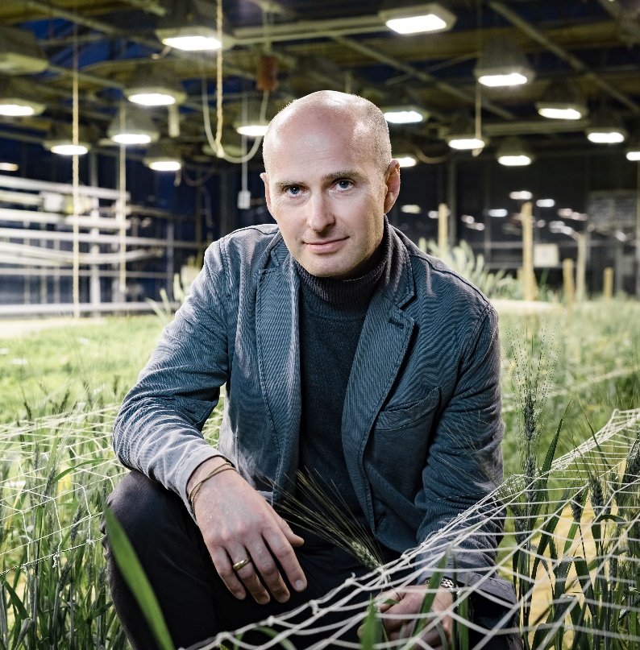



Contact
apl. Prof. Dr. Friedrich Longin
State Plant Breeding Institute, University of Hohenheim,
Fruwirthstrasse 21
70593 Stuttgart, Germany
Phone: (++49) 0711 459 23846
friedrich.longin@uni-hohenheim.de
© Steffen Hoeft

